Slide 1
NYPD OffIcer 360
Lilly Bayly

Slide 2


Information story
In New York City, complaints of police misconduct are handled by the Civilian Complaint Review Board
Inhabitants of New York City may be curious about the police officers in their area and want to search on an officer level
Having easy access to this information in a way that can be understood by a layperson is important for transparency and accountability

Slide 3
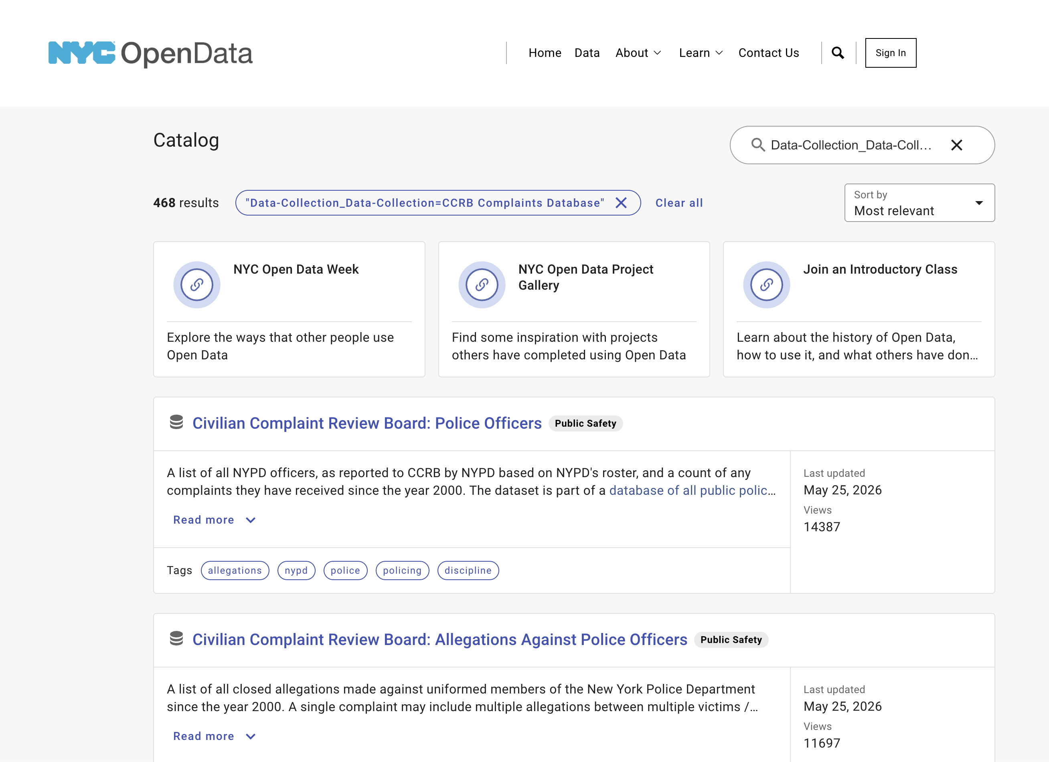
Existing structure

Slide 4
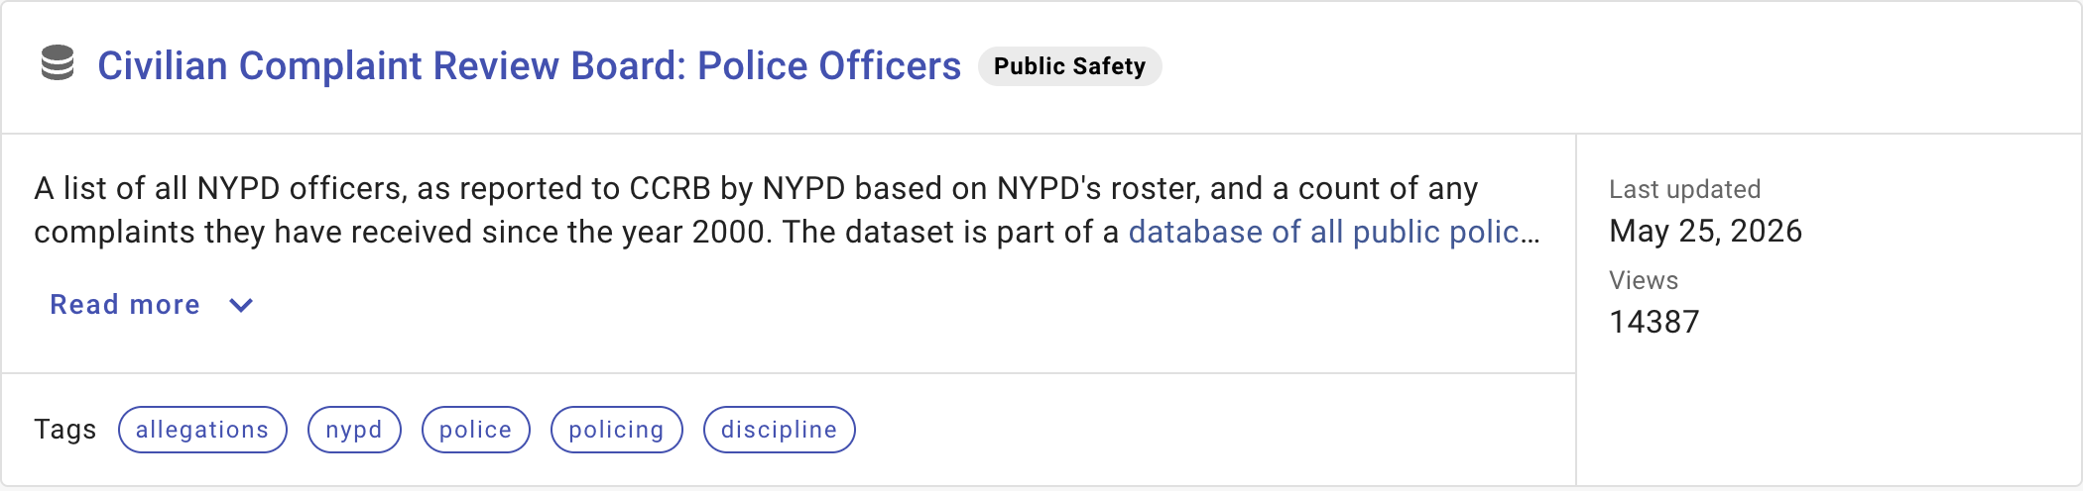
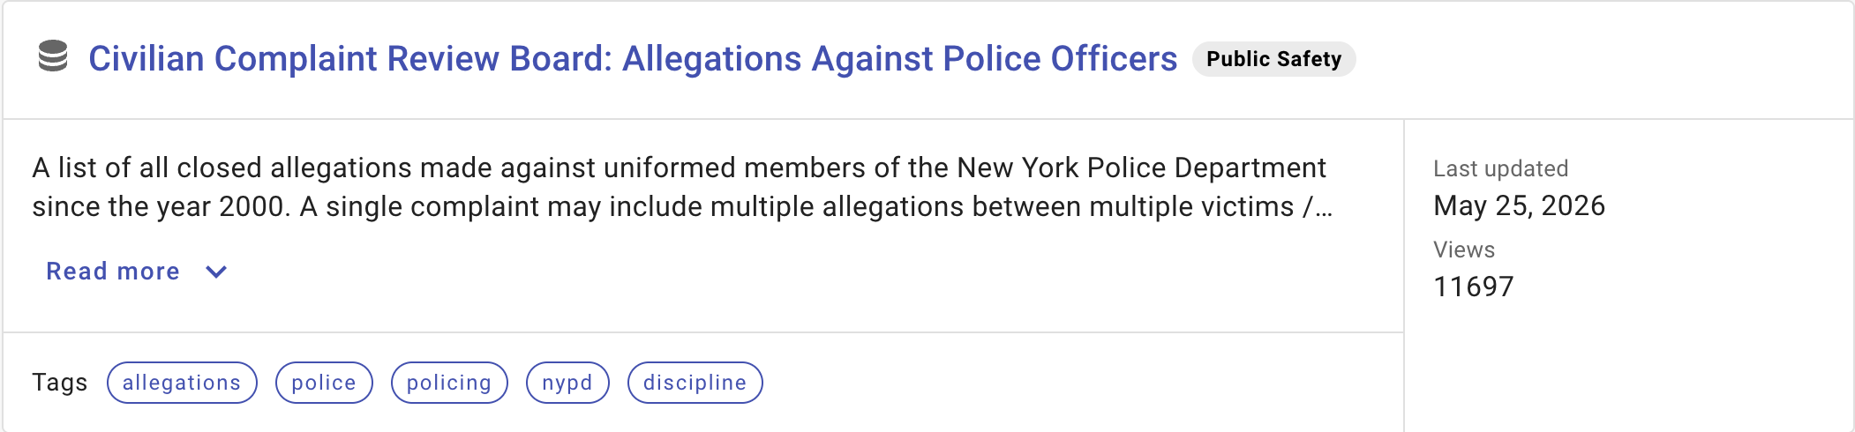
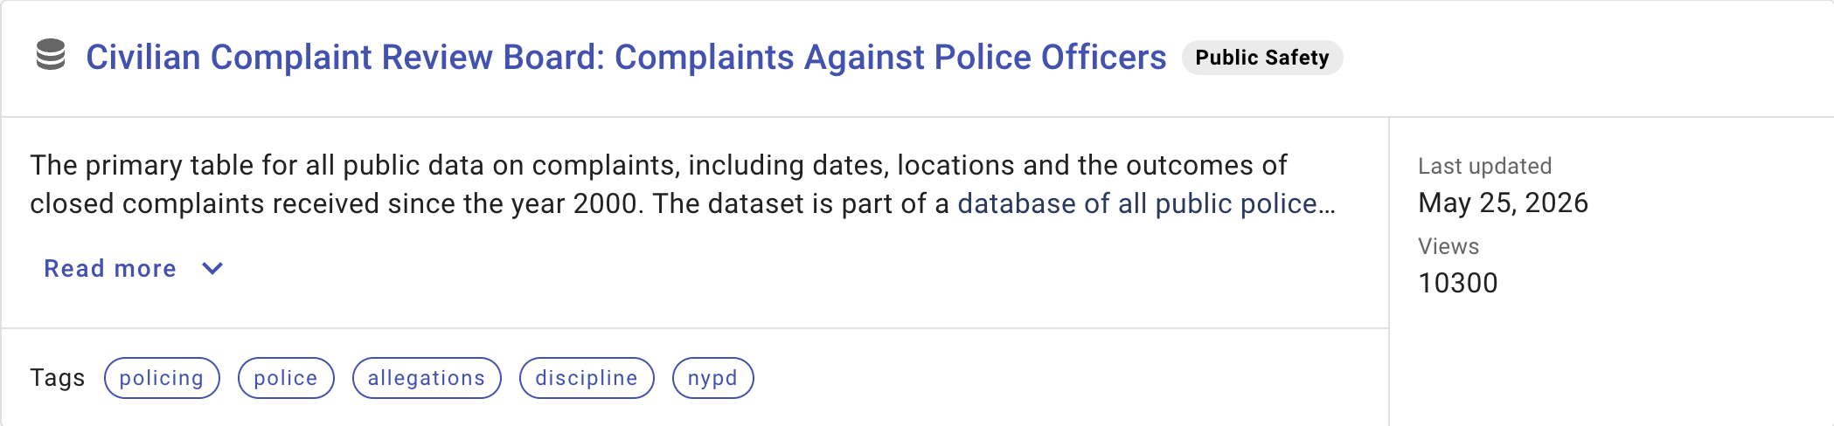
Existing structure

Slide 5
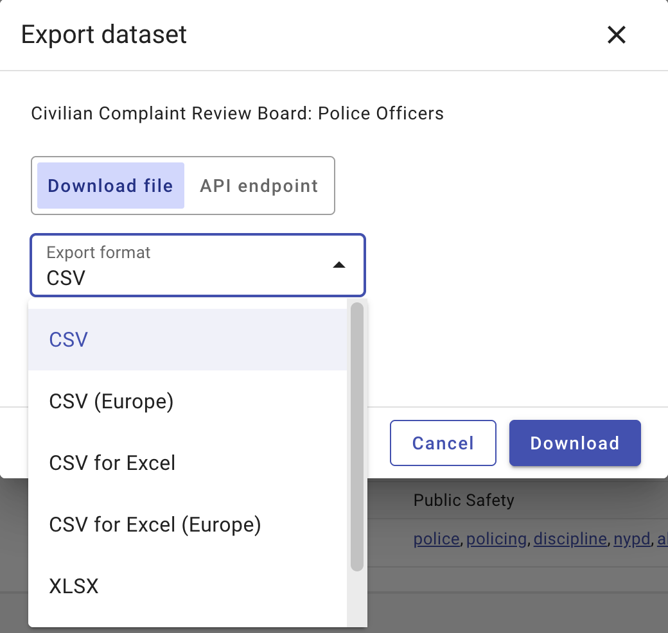
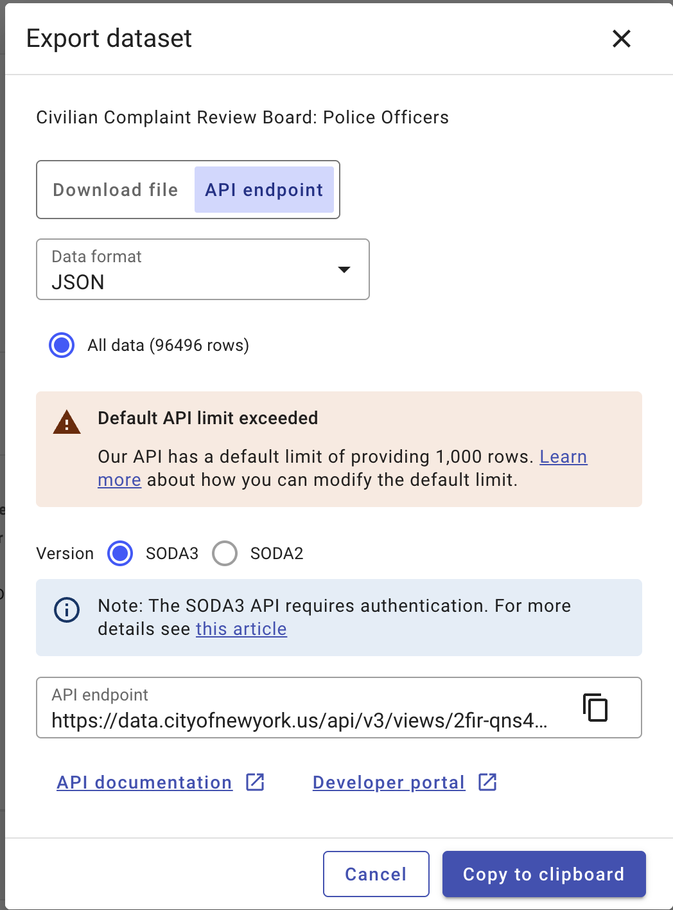
Existing structure

Slide 6
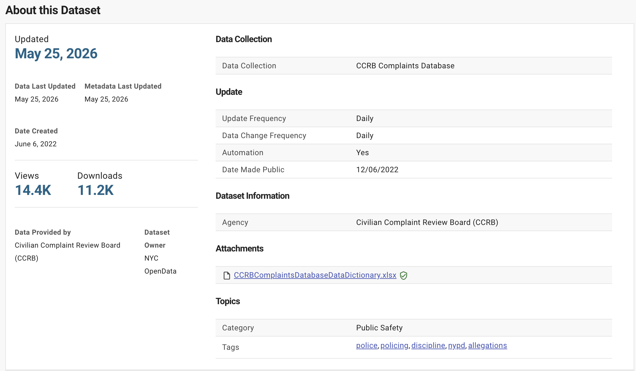
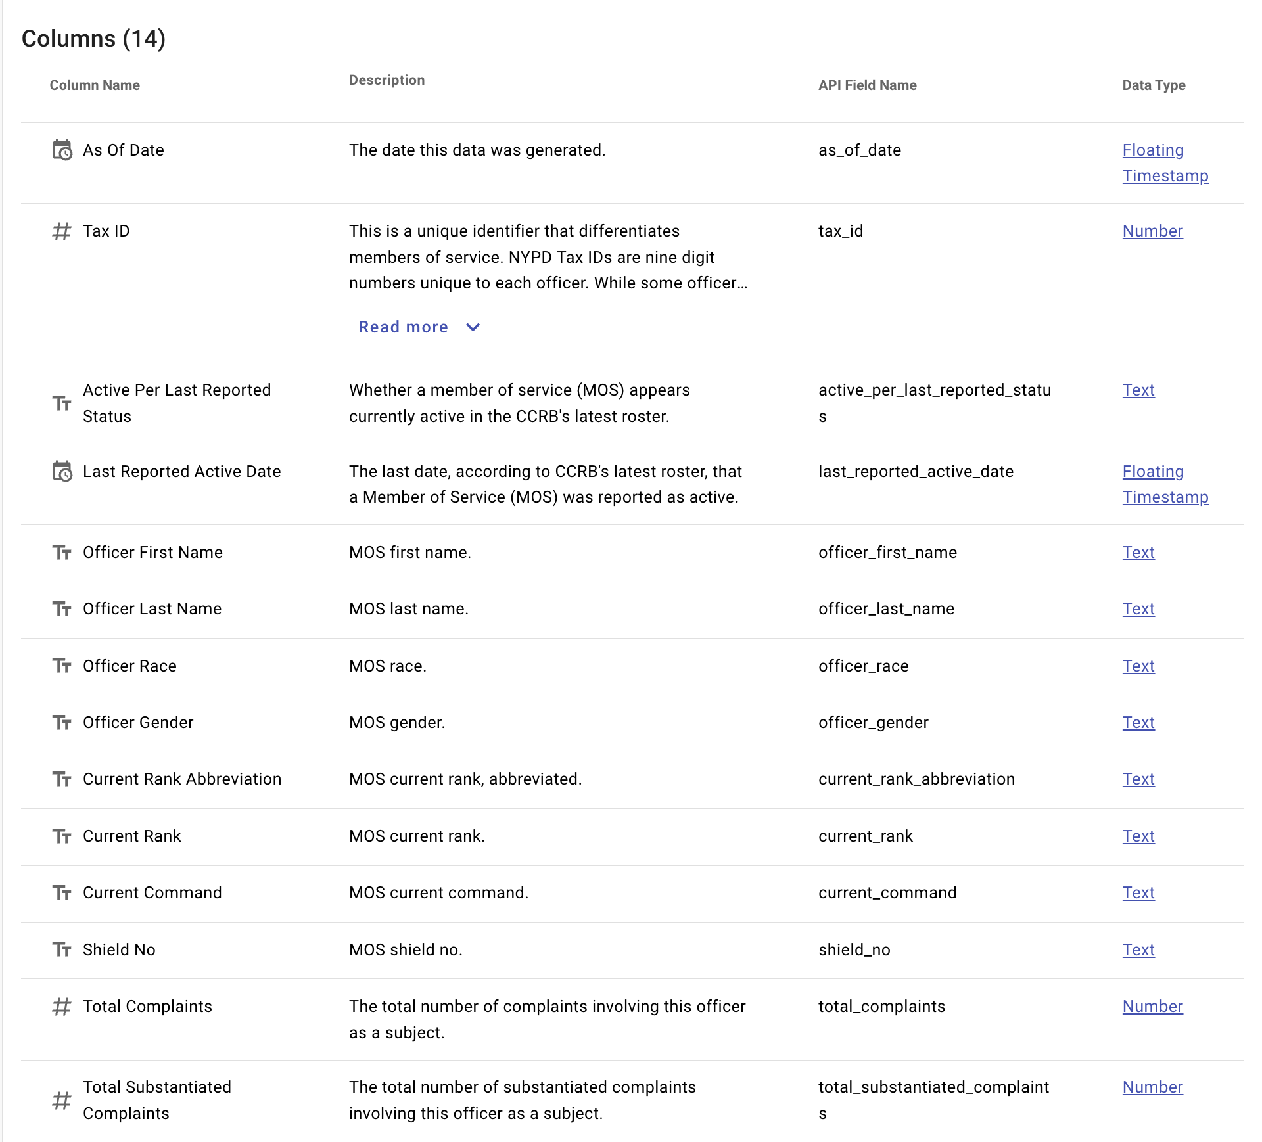
Existing structure

Slide 7
FAIR assessment
This project integrates different datasets about the New York City Police Department that are available through the New York City Open Data portal. Each of the base data sets comes with a set of metadata (F, I, R) that clearly lays out how the data was created and have data dictionaries to go along with them to explain terms used (I). This metadata has been enhanced with further information from other sources, and will be provided as a set of metadata and explanation of terms to provide context for the information (A, I, R). The final dataset will be searchable to allow for easy information retrieval and will also be exportable as a csv file (F, I). The data and metadata can be reused by others following the steps outlined above (R).

Slide 8
Changes & improvements to the structure

Slide 9
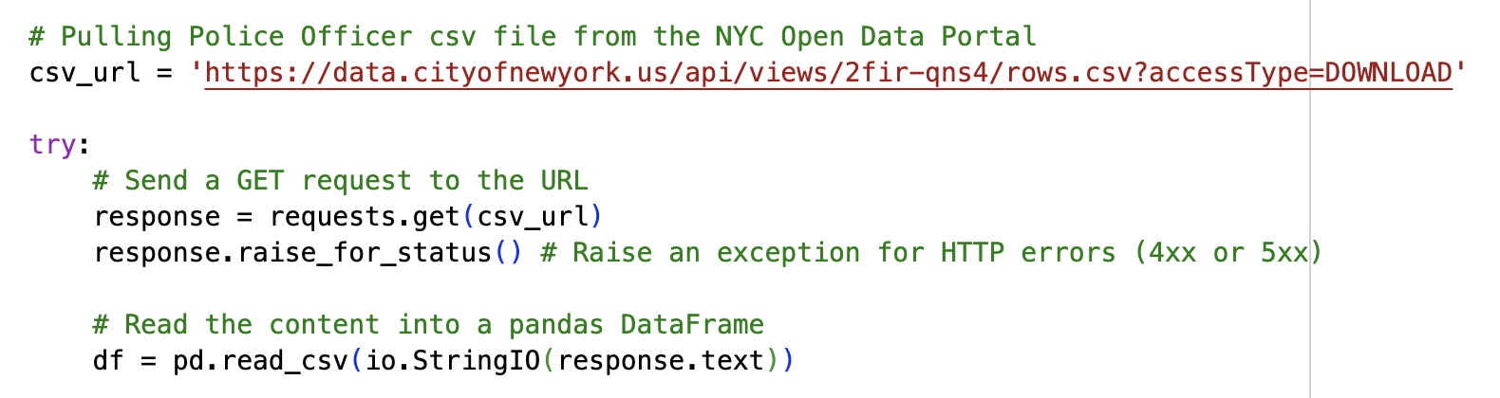
Step 1: Pull data from portal

Slide 10
Step 2: filter, merge, reformat, export
Filter for active officers – reduces the number of records, and makes sense for information story
Merge three csv files on shared keys
Active officers and allegations on Tax ID
Merge resulting dataframe with complaints on Complaint ID
Filter by borough (Manhattan, Queens, Brooklyn, Staten Island, Bronx) – user can make their own choice
Filter out duplicate or out of date columns
Reformat dates so that they can be ingested into AirTable
Export resulting csv from notebook

Slide 11
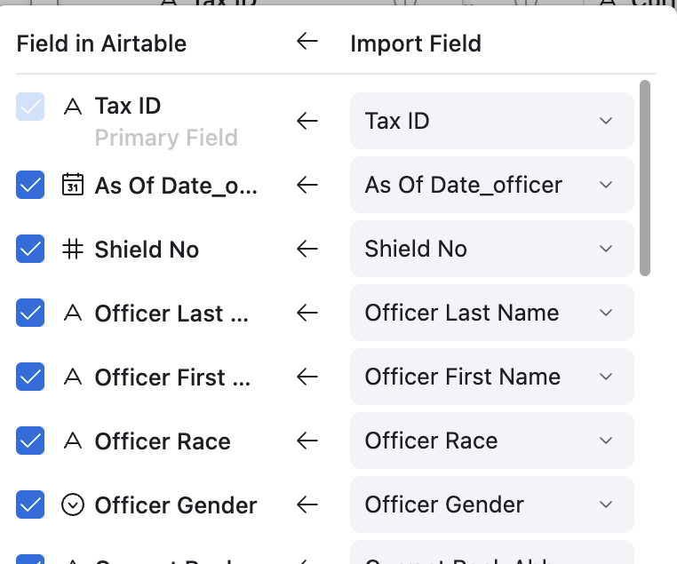
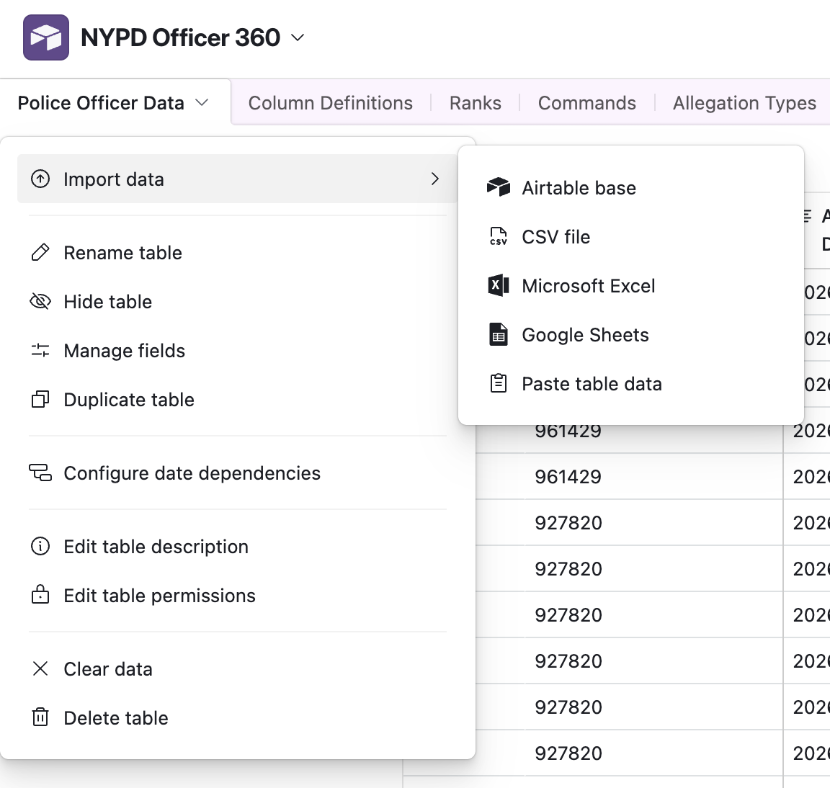
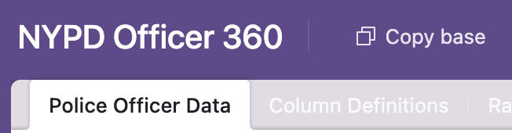
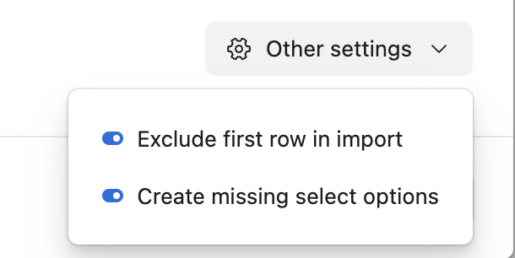
Step 3: Upload into airtable
Make a copy of the template for personal use
Columns automatically map on upload, including the associated column metadata

Slide 12
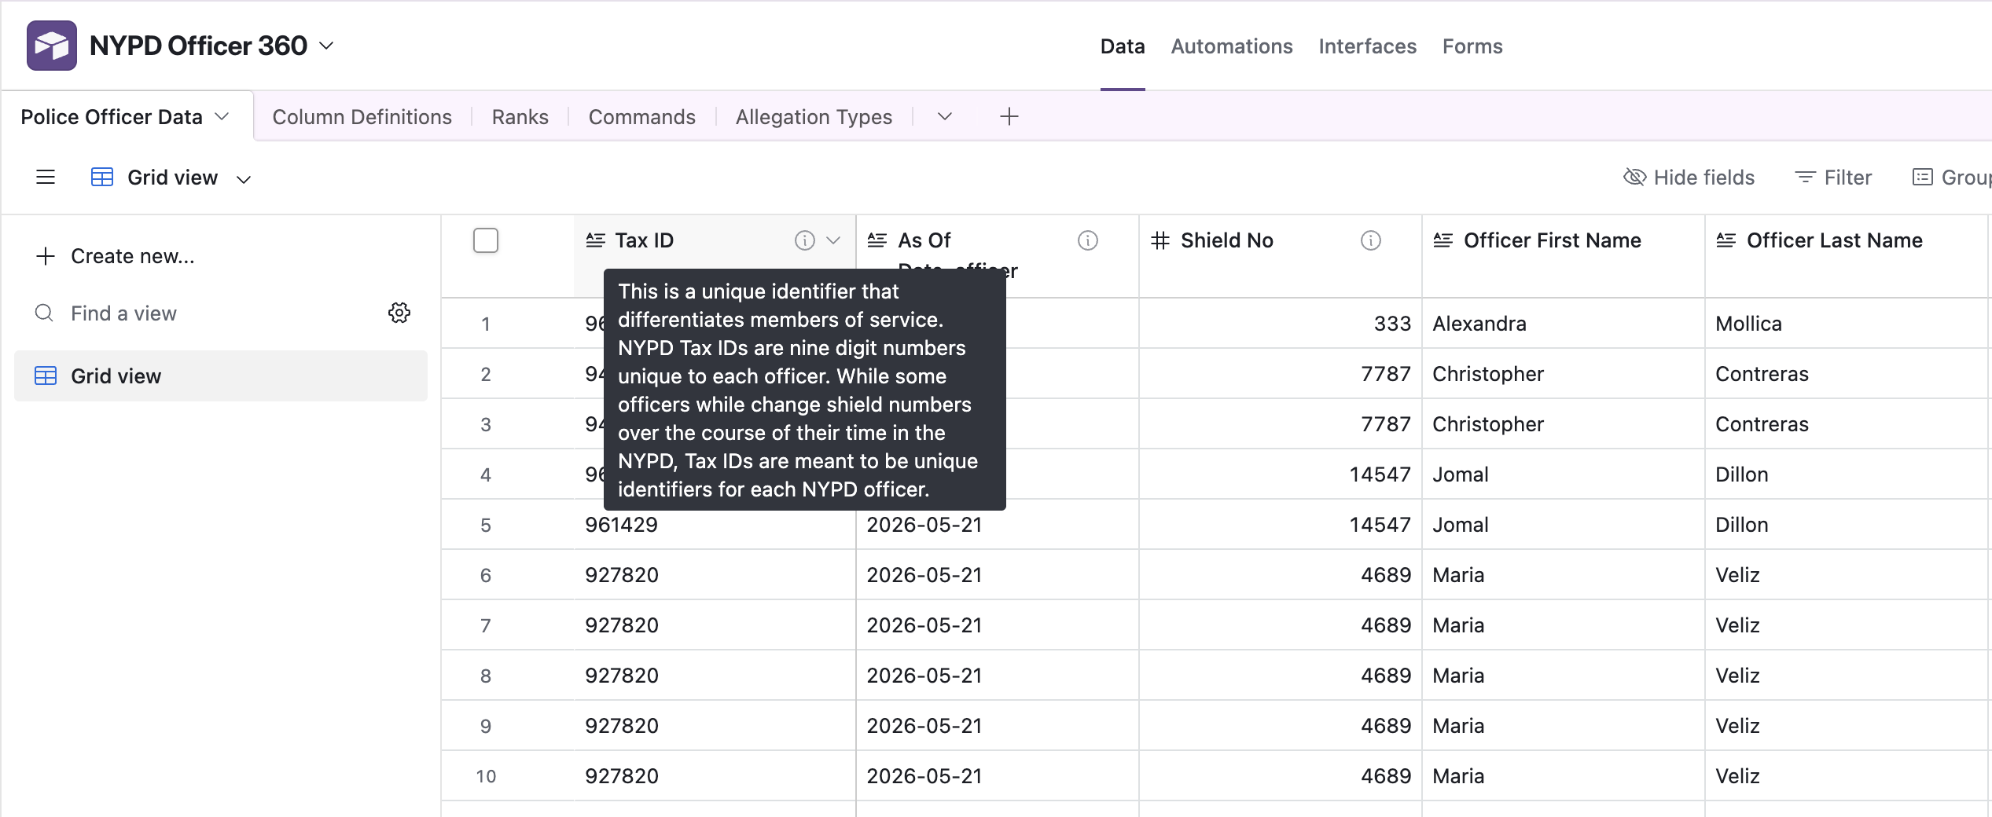
Step 4: using airtable

Slide 13
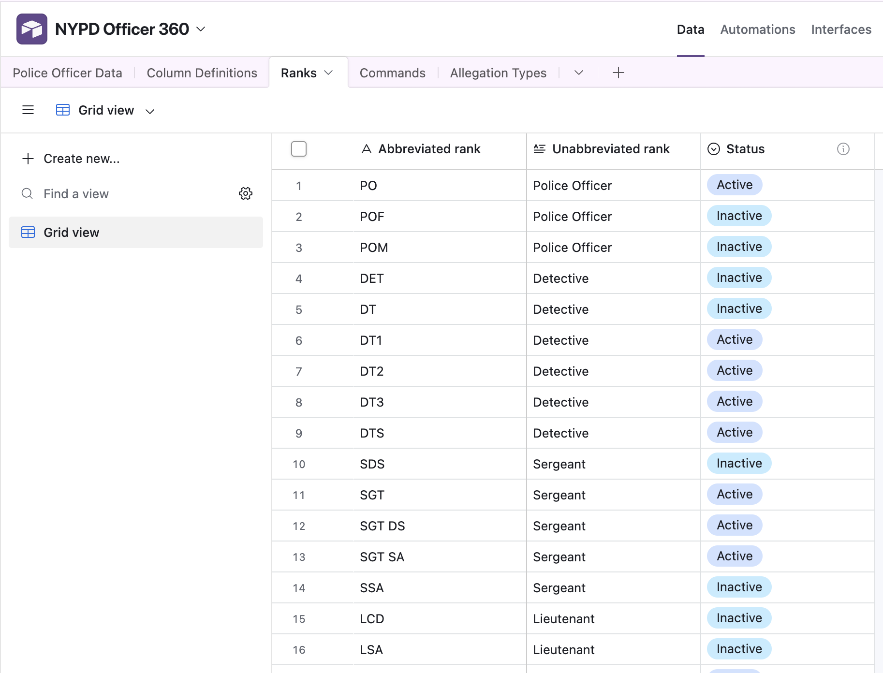
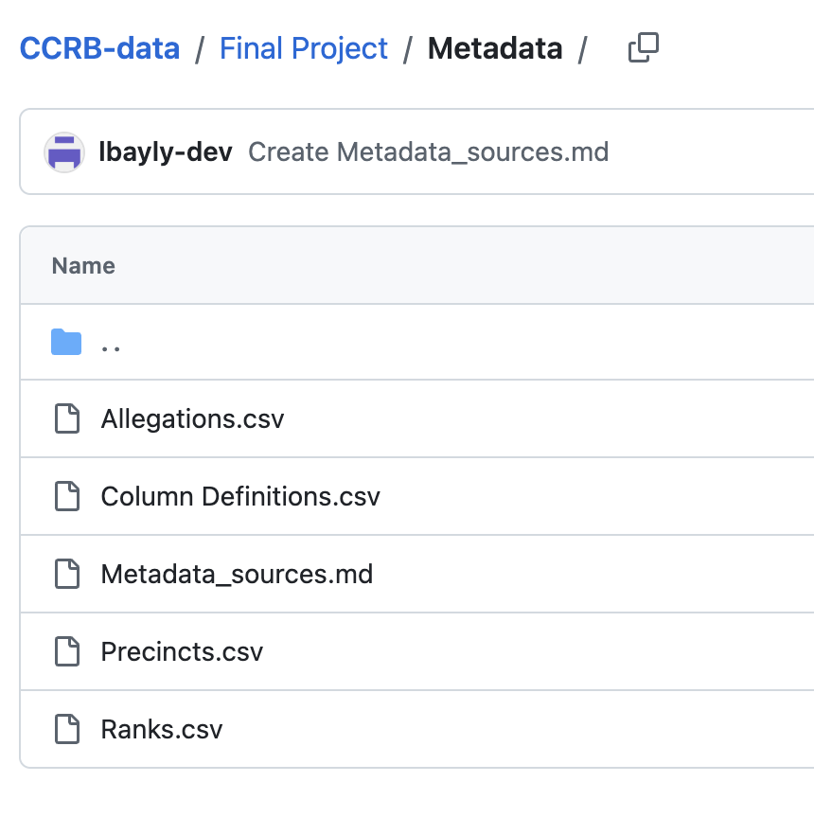
Metadata

Slide 14
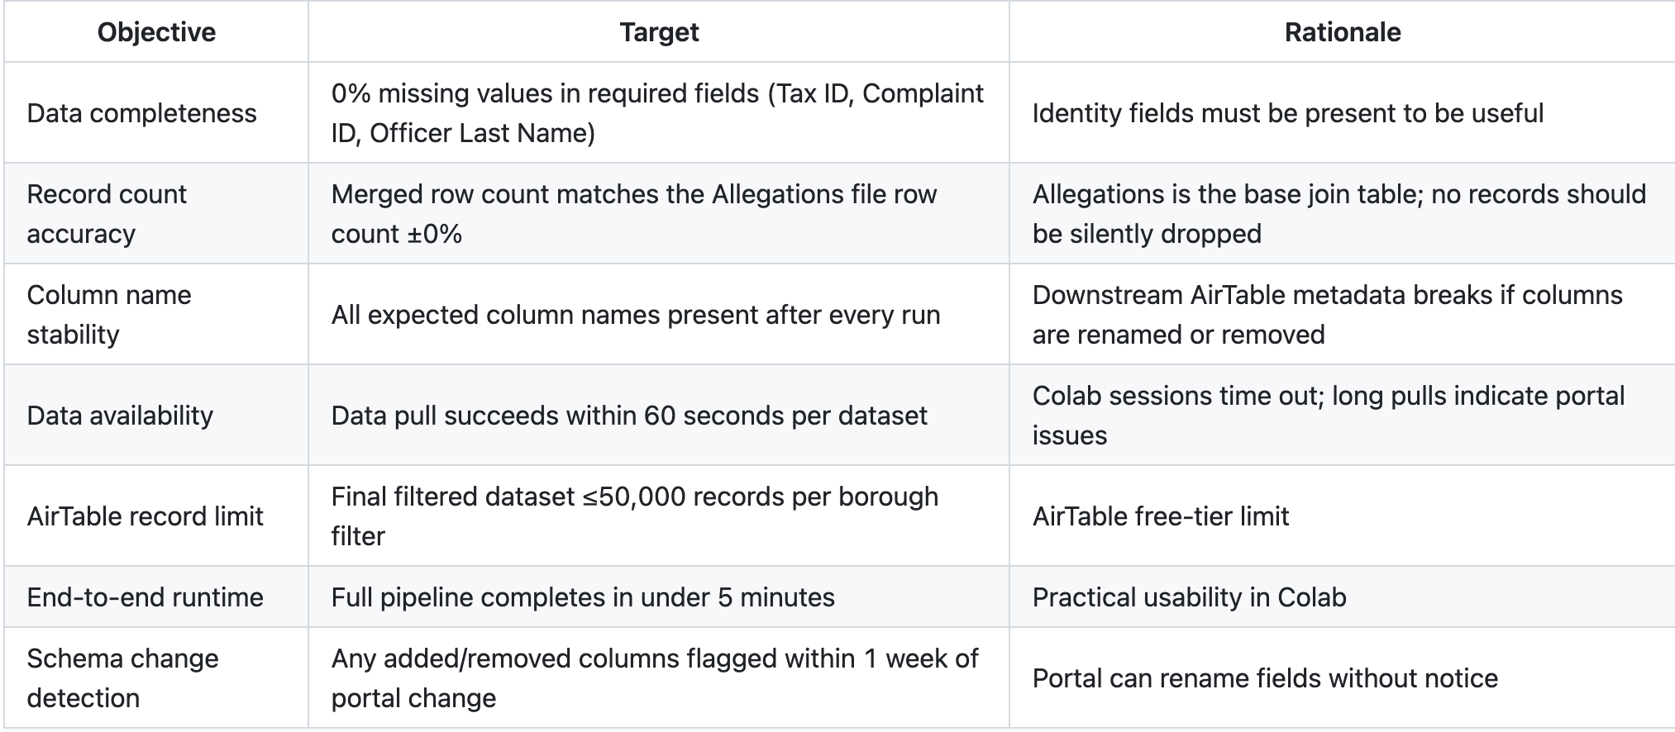
Quality and performance

Slide 15
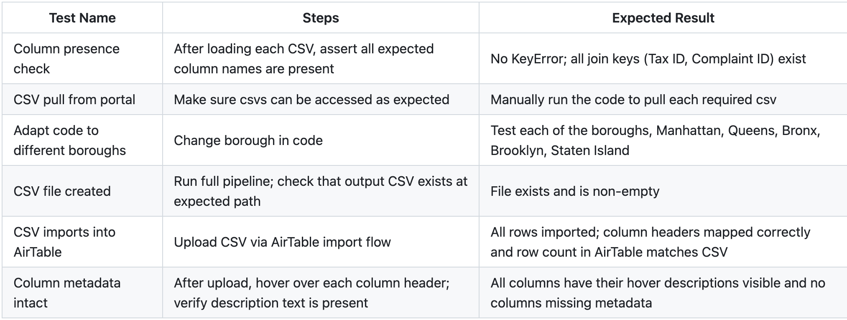
Functional tests

Slide 16
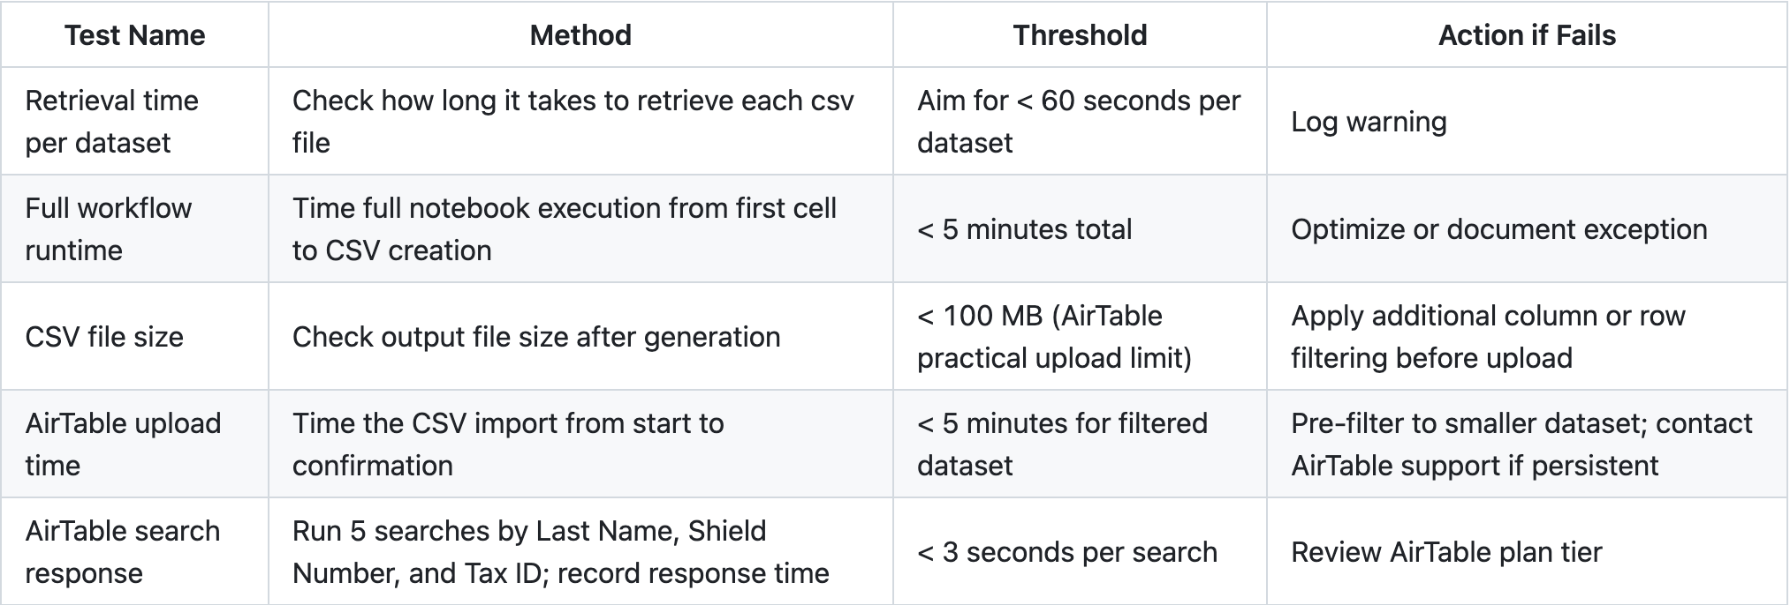
performance tests

